Slide 1
Structure of matter
Radioactivity

Slide 2
Radioactivity
Radioactivity is a property, exhibited by certain types of matter, of emitting energy and subatomic particles spontaneously. It is an attribute of individual atomic nuclei; is a natural phenomenon, present everywhere: in stars, in the Earth and in living organism.

Slide 3
Structure of the atom
The nucleus of the atom is composed of protons (positive electric charge +) and neutrons (zero charge).
The atom is electrically neutral: the nucleus is surrounded by electrons (negative electric charge -), equal in number to the protons present in the nucleus.

Slide 4
Structure of the atom
The structure of the atom is the same for all the chemical elements. What changes from one element to another one is the number of protons and neutrons. The total number of protons in the nucleus is called "atomic number" and is indicated by the letter Z. The chemical element with 8 protons is oxygen (O), that with 26 protons is iron, that with 79 protons is gold and so on...

Slide 5
Isotopes
In a nucleus of an element there may be N neutrons, the sum A = N + Z is called mass number. The nuclei with the same value of Z (protons) but different values of A (that is, with a different number of neutrons) are called isotopes.

Slide 6
Radioactive isotopes
The isotopes present in nature are almost all stable. However, some natural isotopes, and almost all artificial isotopes, are unstable due to an excess of protons and / or neutrons. Such instability causes their spontaneous transformation into other isotopes accompanied by particle emission (radiation). These isotopes are called radioactive isotopes.

Slide 7
Radioactive decay
The transformation of a radioactive isotope produce another isotope, which can be radioactive or stable. This transformation is called radioactive decay. Is not possible to determine the exact instant in which single isotopes will decay. The radioactive decay, in each isotopes, respect a well know statistic frequency.

Slide 8
Half Life
Half-life is the interval of time required for one-half of the atomic nuclei of a radioactive sample to decay (change spontaneously into other nuclear species by emitting particles and energy), or, equivalently, the time interval required for the number of disintegrations per second of a radioactive material to decrease by one-half.

Slide 9
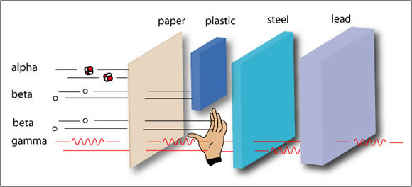
Radiation and Shield
There are three different types of radioactive decay, which differ from the type of particle emitted following decay. The emitted particles are indicated by generic name of radiation.
Alfa
Beta
Gamma

Slide 10
Alfa Decay
Following an alpha decay, the nucleus (Z, A) emits a particle alfa ( a helium nucleus = 2 protons + 2 neutrons) and converts to a different nucleus with atomic number (Z - 2) and mass number (A-4).

Slide 11
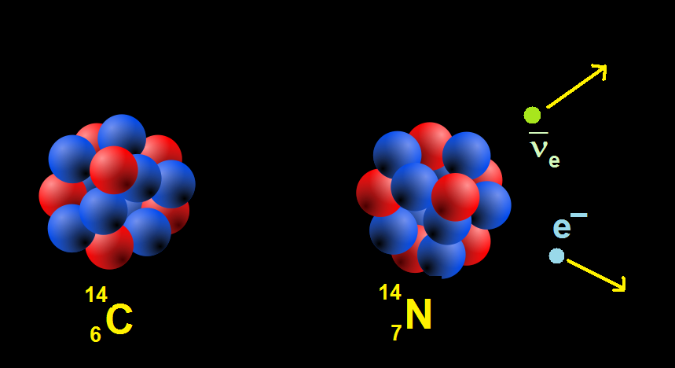
Beta Decay
The nucleus emits an electrons and an anti-neutron and becomes a nucleus with charge (Z + 1), but same mass number A.

Slide 12
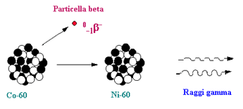
Gamma decay
The nucleus does not transform but passes into a lower state of energy and emits a photon; gamma radiation often accompanies that a or b.

Slide 13
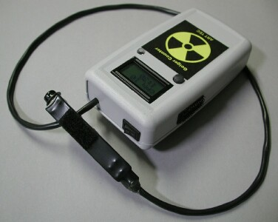
Gieger Counter
The activity of a radioactive source is defined as the number of decays in the unit of time. It is measured in Bequerel (Bq) which is equivalent to a decay per second. The instrument to measure the radioactive activity is the Geiger counter.

