Slide 1
Structure of matter
Ionising radiation

Slide 2
Definition of Radiation
Radiation is an energy in the form of electro-magnetic waves or particulate matter, traveling in the air.
Definition of Ion
Ions are atoms with extra electrons or missing electrons. When an atom gains or loses electrons, the atom forms an ion.

Slide 3
Types Radiation
Ionizing Radiation
Non-ionizing radiation

Slide 4
Ionizing vs Non-ionizing
Ionizing Radiation
Higher energy electromagnetic waves (x-ray, gamma-ray) or heavy particles (alpha and beta).
High enough energy to liberate electron from orbit.
Non-ionizing Radiation
Lower energy electromagnetic waves (infrared, visible, microwave).
Not enough energy to pull electron from orbit, but can excite the electron.

Slide 5
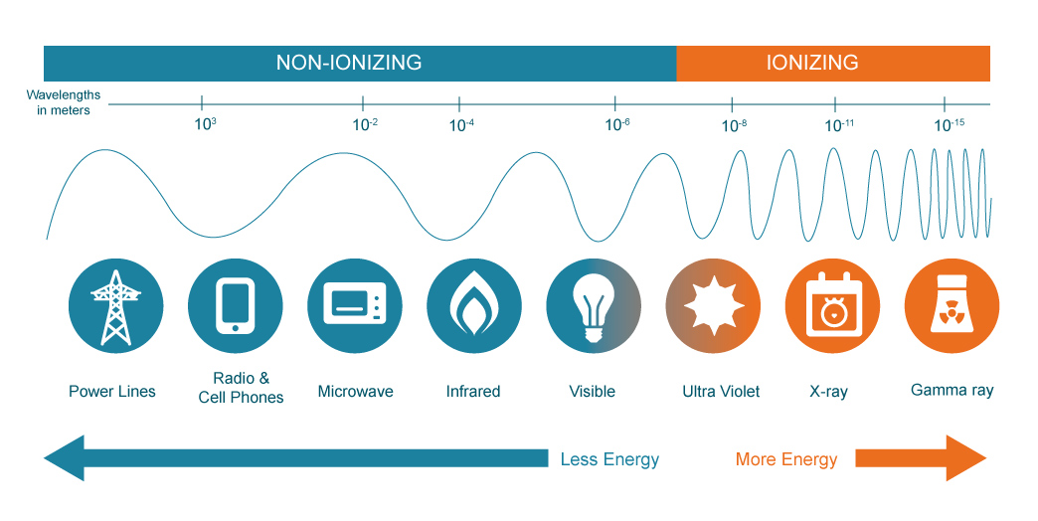
Radiation

Slide 6
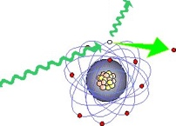
Ionizing radiation
A radiation is said to be ionizing when it has enough energy to liberate one or more electrons from the atoms or molecules in the irradiated medium. This is the case of electromagnetic radiations such as gamma radiations, X-rays and some ultra-violet rays. Visible or infrared light are not ionizing, nor are microwaves or radio waves.

Slide 7
Forms of Ionizing Radiation
GAMMA
Deep penetrating
Need steel, lead, etc. to shield
X –Radiation
Commonly thought of as electromagnetic radiation produced by an x-ray machine
Penetration depends on wavelength and material being irradiated.
Often use concrete to shield

Slide 8
Forms of Ionizing Radiation
ALPHA
Travel only a short distance in air (~ 4” in air)
Stopped by dead skin, film of water, sheet of paper
Very hazardous when taken into the body
Avoid inhalation or ingestion
BETA
Penetrate human body to depth of 0.1-o.5”
Can penetrate wood to about 1.5”
Stopped by 0.5” aluminum or Plexiglas

Slide 9
Watch this video:
https://www.youtube.com/watch?v=uJ3ea9fa6CA

