Slide 1
Course Name
Photoelectric emission

Slide 2
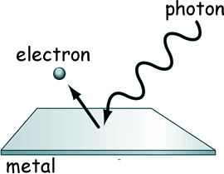
Research into the Photoelectric Effect was initiated in 1887 by H. R. Hertz - does the name sound familiar? The unit of frequency is named after him!
Herts discovered that if ultra-violet light was shone on a spark gap in a vacuum tube, it facilitated the passage of the spark. That led immediately to a series of investigations within Universities and the photoelectric effect was discovered.

Slide 3
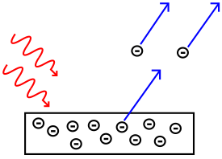
The photoelectric effect is based on the idea that electromagnetic radiation is made of a series of particles called photons
When a photon hits an electron on a metal surface, the electron can be emitted. The emitted electrons are called photoelectrons
A diagram that shows how electrons are emitted from a metal plate

Slide 4
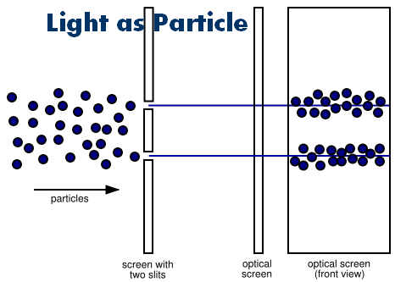
The photoelectric effect has helped physicists understand the quantum nature of light and electrons. The concept of wave–particle duality was developed because of the photoelectric effect

Slide 5
Not every electromagnetic wave will cause the photoelectric effect, only radiation of a certain frequency or higher. The minimum frequency needed is called the "cut off frequency" or "threshold frequency'. The cut off frequency is used to find the work function, w, which is the amount of energy holding the electron to the metal surface. The work function is a property of the metal and is not affected by the incoming radiation. If a frequency of light strikes the metal surface that is greater than the cut off frequency, then the emitted electron will have some kinetic energy off.

Slide 6
The energy of a photon causing the photoelectric effect is found through
E = hf = KE + w,
where:
h is Planck's constant, 6.626X10^(-34) J*s,
f is the frequency of the electromagnetic wave,
KE is the kinetic energy of the photoelectron and
w is the work function for the metal.
If the photon has a lot of energy, compton scattering(~thousands of eV) or pair production(~millions of eV) may take place.

Slide 7
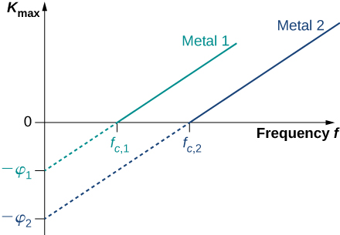
The intensity of the light does not cause ejection of electrons, only light of the cut off frequency or higher can do that. However increasing the intensity of light will increase the number of electrons being emitted, as long as the frequency is above the cut off frequency.

