Slide 1
Structure of Matter
The electron

Slide 2
Niels Bohr and Ernest Rutherford in 1913 introduced the Rutherford–Bohr model or Bohr model or Bohr diagram.
This model depicts the atom as a small, positively charged nucleus surrounded by electrons
The electrons travel in circular orbits around the nucleus - similar to the Solar System!

Slide 3
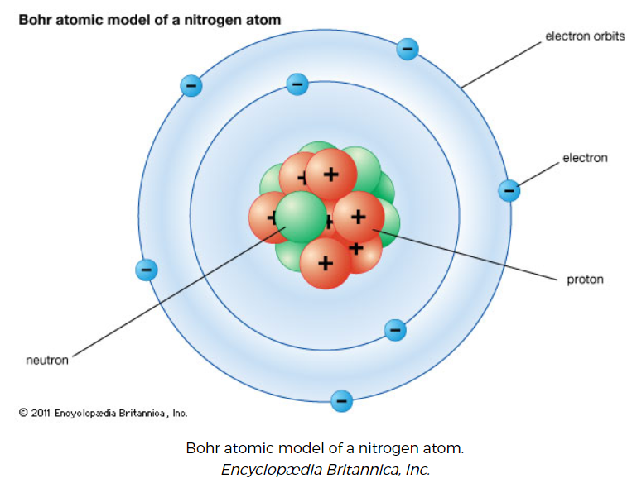
Source: https://www.britannica.com/science/Bohr-atomic-model

Slide 4
Main aspects of the BOHR model
Electrons orbit the nucleus in orbits that have a set size and energy
The energy of the orbit is related to its size: lowest energy is found in the smallest orbit
Radiation is absorbed or emitted when an electron moves from one orbit to another

Slide 5
Bohr used the term energy levels to describe the electron orbits of differing energy
He said that the energy of an electron is quantized, meaning electrons can have one energy level or another but nothing in between
The energy level an electron normally occupies is called its ground state: it can move to a higher-energy, less-stable level, or shell, by absorbing energy (the electron’s excited state)

Slide 6
After an electron is being excited, it can return to its original ground state by releasing the energy it has absorbed
Sometimes the energy released by electrons occupies the portion of the electromagnetic spectrum that humans detect as visible light
Slight variations in the amount of the energy are seen as light of different colours

Slide 7
