Slide 1
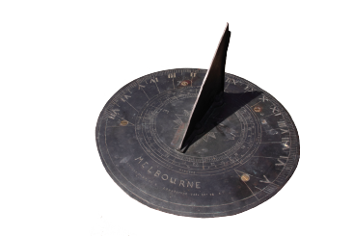
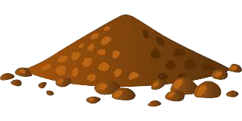
IN QUEST OF THE ATOM
The question about the foudamental elements of matter is ancient. E.g. Presocratic philosophers have proposed several candidates: water (Thales), air (Anaximenes), fire (Heraclitus), all of the above plus earth (Empedocles), the infinite (Anaximander), or geometrical “atoms”, i.e. indivisibles (Leucippus & Democritus).
Notes:
‹#›

Slide 2
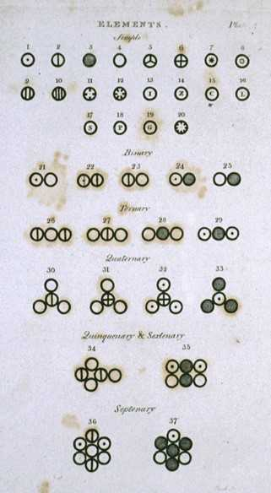
IN QUEST OF THE ATOM
But it was only until the 19th century that the discoveries of chemistry led to an adequate atomic theory: Every matterial substance consists of discrete units. These units were thought to be indivisible and were called “atoms”.
See on the right a page from J. Dalton's book A New System of Chemical Philosophy.
Notes:
‹#›

Slide 3
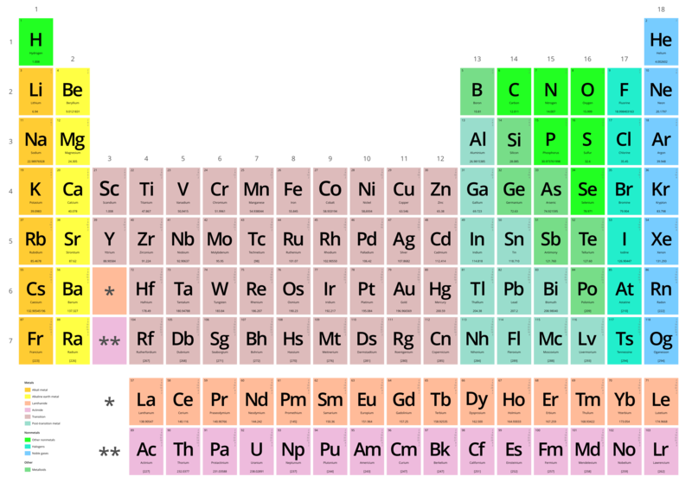
IN QUEST OF THE ATOM
There are many kinds of substances or “chemical elements” and thus many kinds of atoms.
The periodic table includes all the chemical elements found in nature.
Notes:
‹#›

Slide 4
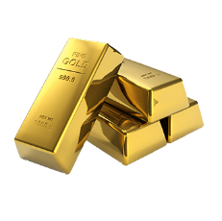
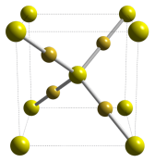
IN QUEST OF THE ATOM
Atoms are combined in different ways creating different materials. Some materials consist of only one chemical element (they are structured by atoms of the same kind):
Oxygen ( O )
Carbon ( C )
Gold ( Au )
Molecules of oxygen
Structure of carbon*
Structure of gold*
* The colours on the atoms are only indicative, not real.
Notes:
‹#›

Slide 5
IN QUEST OF THE ATOM
But most materials consist of more than one elements. E.g. a molecule of water consists of one atom of oxygen and two atoms of hydrogen.
Water ( H2O )
Molecules of water ( H2O )
One atom of oxygen ( O )
Two atoms of hydrogen ( H )
Notes:
‹#›

Slide 6
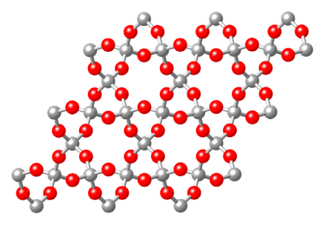
IN QUEST OF THE ATOM
Air consists of Nitrogen ( N2 ), Oxygen ( O2 ), Argon ( Ar ), Carbon dioxide ( CO2 ) and other substances.
Quartz ( SiO2 ), a basic component of soil, consists of silicon and oxygen atoms.
Notes:
‹#›

Slide 7
IN QUEST OF THE ATOM
Discoveries in the physics of gases (Avogadro's law) and of liquids (Brownian motion) confirmed the most ideas of the atomic theory.
On the right you may see the “Brownian” motion of a dust particle which collides with molecules of a liquid (from J.B. Perrin's book, Les Atomes).
Notes:
‹#›

Slide 8
IN QUEST OF THE ATOM
... but in the late 19th century the discovery of different radiations emitting from matter showed that the atoms were not the smallest elements of matter.
Notes:
‹#›

Slide 9
IN QUEST OF THE ATOM
In 1897, electromagnetic experiments carried out by J. Thomson led to the discovery of the cathode rays. These rays consisted of particles which were 1800 times smaller than the smallest atoms. The new particle, which was later named “electron”, was a constituent of the atom.
See below the cathode rays (depicted with blue colour) within the Crookes tube, as it was modified by Thomson.
Notes:
‹#›

Slide 10
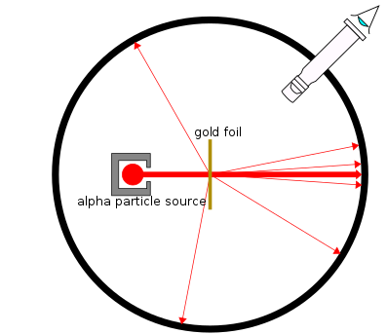
IN QUEST OF THE ATOM
More constituents of the atom were discovered, in 1909, by E. Rutherford. A-rays were shot at a thin gold foil and presented heavy deflection. This signified that the atom included, except from the electrons, a massive nucleus.
See on the right a representation of the experiment.
Notes:
‹#›

Slide 11
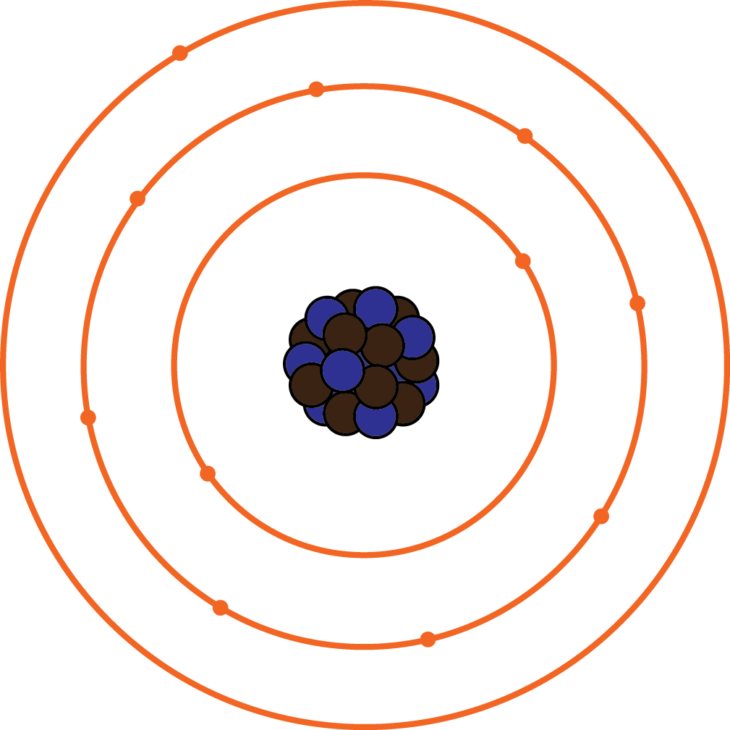
IN QUEST OF THE ATOM
In 1913 N. Bohr discovered that electrons could only orbit the nucleous in specific circular orbits with fixed energy. According to the Bohr model of the atom, the energy of each electron depends on its orbit.
See on the right a representation of the Bohr model.
Electrons orbiting in different energy levels
Notes:
‹#›

Slide 12
IN QUEST OF THE ATOM
Further experiments by Rutherford, revealed in 1917 that the nucleus of the atom was divisible and it consisted of two kinds of particles: neutrons and protons.
See on the right the representation of neutrons and protons of the nucleus. The colours are only indicative, not real.
Notes:
‹#›

Slide 13
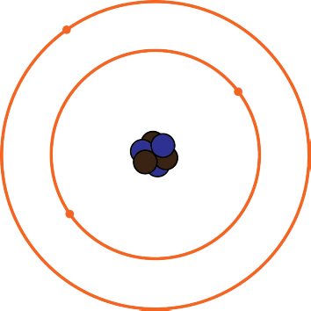
STRUCTURE OF THE ATOM
Lets take a more detailed view of the atomic structure according to the Bohr model:
Neutrons and protons constitute the nucleus (the core) of each atom, while electrons, which are 1.800 times smaller, orbit the nucleus in orbits of different energy levels.
Notes:
‹#›

Slide 14
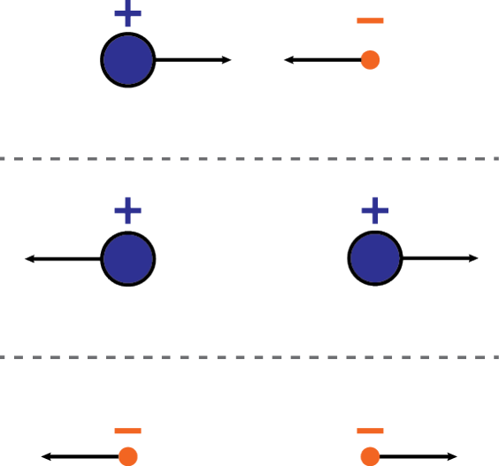
STRUCTURE OF THE ATOM
Protons and electrons are carriers of opposite electric charge –labeled as “possitive” and “negative” charge respectively– and they are attracted to each other, while they repel particles of the same kind. These forces are called 'electric attraction' and 'electric repulsion'.
Notes:
‹#›

Slide 15
STRUCTURE OF THE ATOM
Thus, electrons are hold around the nucleus because they are electrically attracted by the protons.
The more energy electrons have the more distance they have from the nucleus. But they can only bare specific amounts of energy and, thus, they can only occupy specific orbits. The electric repulsion between electrons deteriorates their amount in each orbit.
Notes:
‹#›

Slide 16
STRUCTURE OF THE ATOM
But what happens with the electric repulsion between the protons? Why they are not pushed away from each other? And what about neutrons?
Neutrons and protons are bound to each other with the nuclear force, which, in short distances, is a lot stronger that the electric force. This is how the nucleus is formed.
On the other hand neutrons bear no electric charge (they are “neutral”).
Notes:
‹#›

Slide 17
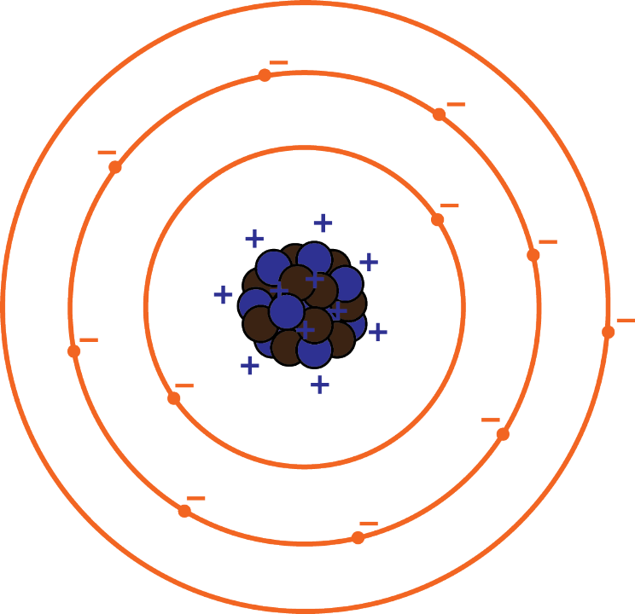
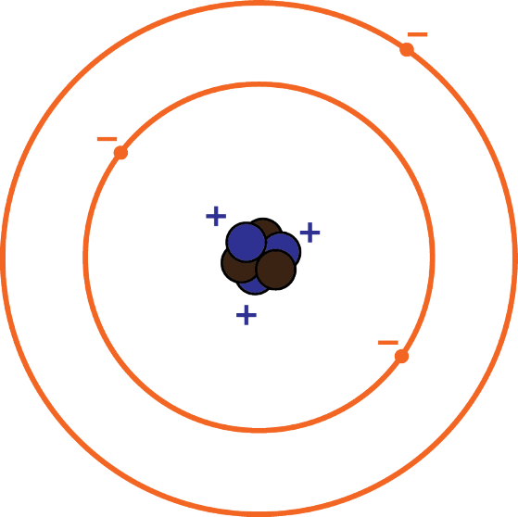
STRUCTURE OF THE ATOM
An atom which contains equal number of protons and electrons is also called “neutral”, because on the whole it has zero charge:
3 protons 3 electrons
11 protons 11 electrons
+11 -11 = 0
+3 -3 = 0
Notes:
‹#›

Slide 18
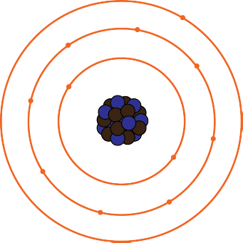
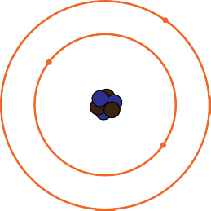
STRUCTURE OF THE ATOM
Electrons with very high energy can move from one atom to another.
In that case the first atom is charged “positively” (it contains more protons than electrons) and the second is charged “negatively”.
positively charged
negatively charged
Notes:
‹#›

Slide 19
STRUCTURE OF THE ATOM
3 protons 4 electrons
11 protons 10 electrons
+11 -10 = +1
+3 -4 = -1
Notes:
‹#›

Slide 20
STRUCTURE OF THE ATOM
The atomic number (Z) of an atom is the number of protons, while the mass number (A) is the sum of protons and neutrons.
Z = 11 (protons)
A = 11 + 11 = 22
Notes:
‹#›

