Slide 1
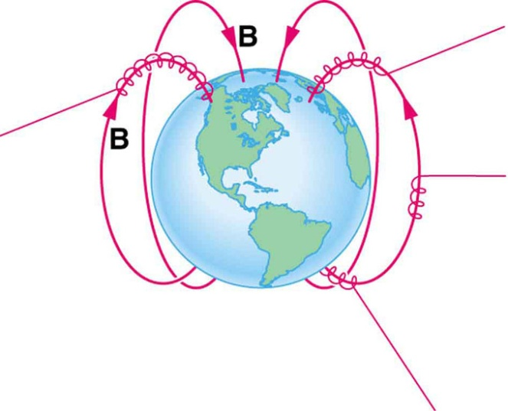
Current in a magnetic field

Slide 2
Force on a Moving Charge
When a charged particle travels through a magnetic field, it experiences a force unlike any other that we're familiar with in everyday life. We call this force Lorentz force.
The strange thing with that kind of force is that the magnetic field cannot exert a force on a charged particle unless there is relative motion between the particle and the field and also just because there's relative motion between the particle and the field, it does not necessarily mean that the particle will experience a force.

Slide 3
Lets examine more closely the factors that determine the strength and direction of the Lorentz force.
The magnitude of this force is proportional to the amount of charge in the particle and the strength of the magnetic field. Also it depends from the angle between the direction of magnetic field and the charged particle’s velocity in such a way that if the particle is traveling perpendicular to the magnetic field lines will experience the maximum force. At other angles the force is less and becomes zero if the particle is traveling parallel to the magnetic field lines.

Slide 4
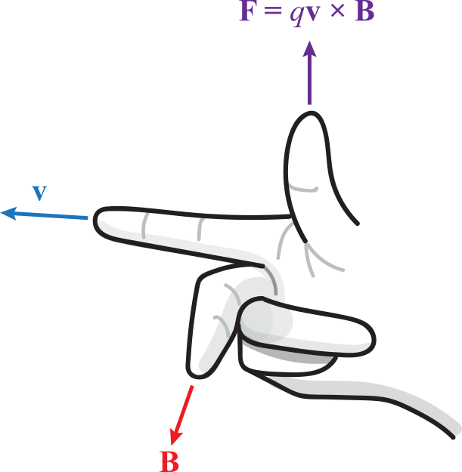
The direction of the Lorentz force is always perpendicular to both the magnetic field and the particle's direction of travel.
For a given direction of moving charge and magnetic field we can find the direction of force if we apply the Right Hand Rule.
F
v
Β

Slide 5
The rule is that if you took your right hand and put your forefinger (first finger) forward pointing at the direction of particles velocity and your second finger pointing at the direction of magnetic field, then the direction of the force for a positive moving charge would be indicated if you stuck your thumb up perpendicular to the other two fingers.
If the moving charge is negative then the force will be at the opposite direction the thump is pointing.

Slide 6
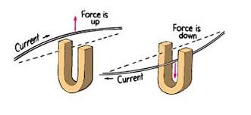
Α current-carrying wire in the magnetic field
Since an electrical current in a wire consists of moving electrons, and these electrons are bound to the conductor, the magnetic forces on the moving charges are transferred to the wire.

Slide 7
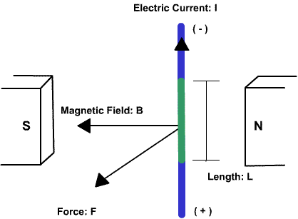
When the current is perpendicular to the direction of the magnetic field, the force equation is: F = BIL
where: F is the force in Newtons, B is the strength of the magnetic field in Teslas, I is the electrical current in Amperes, L is the length of the wire through the magnetic field in meters.

