Slide 1
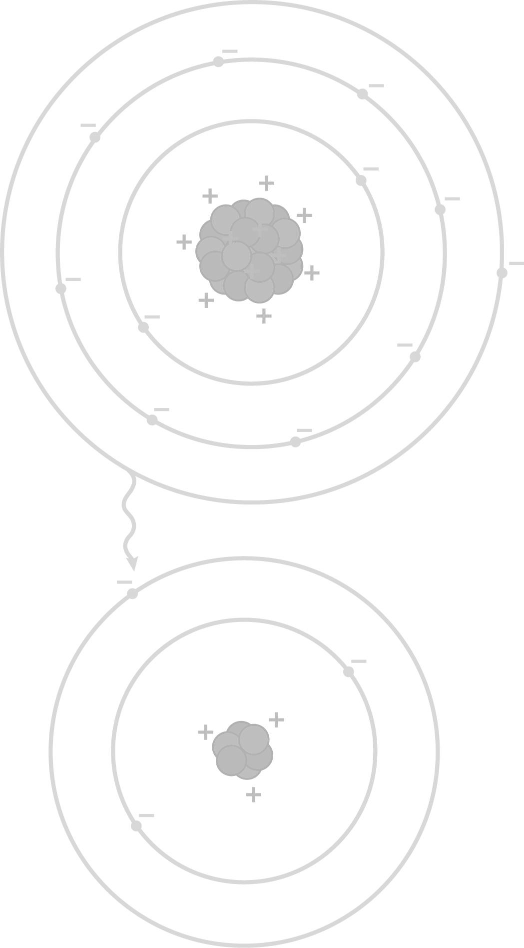
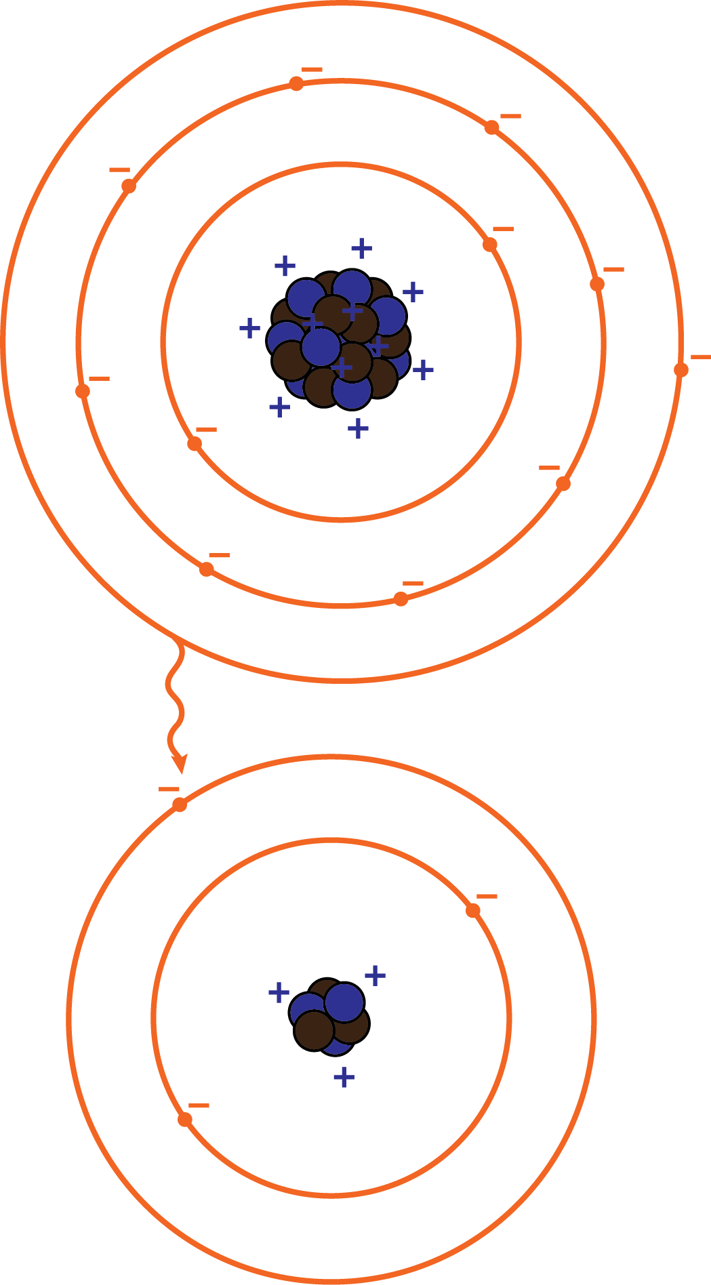
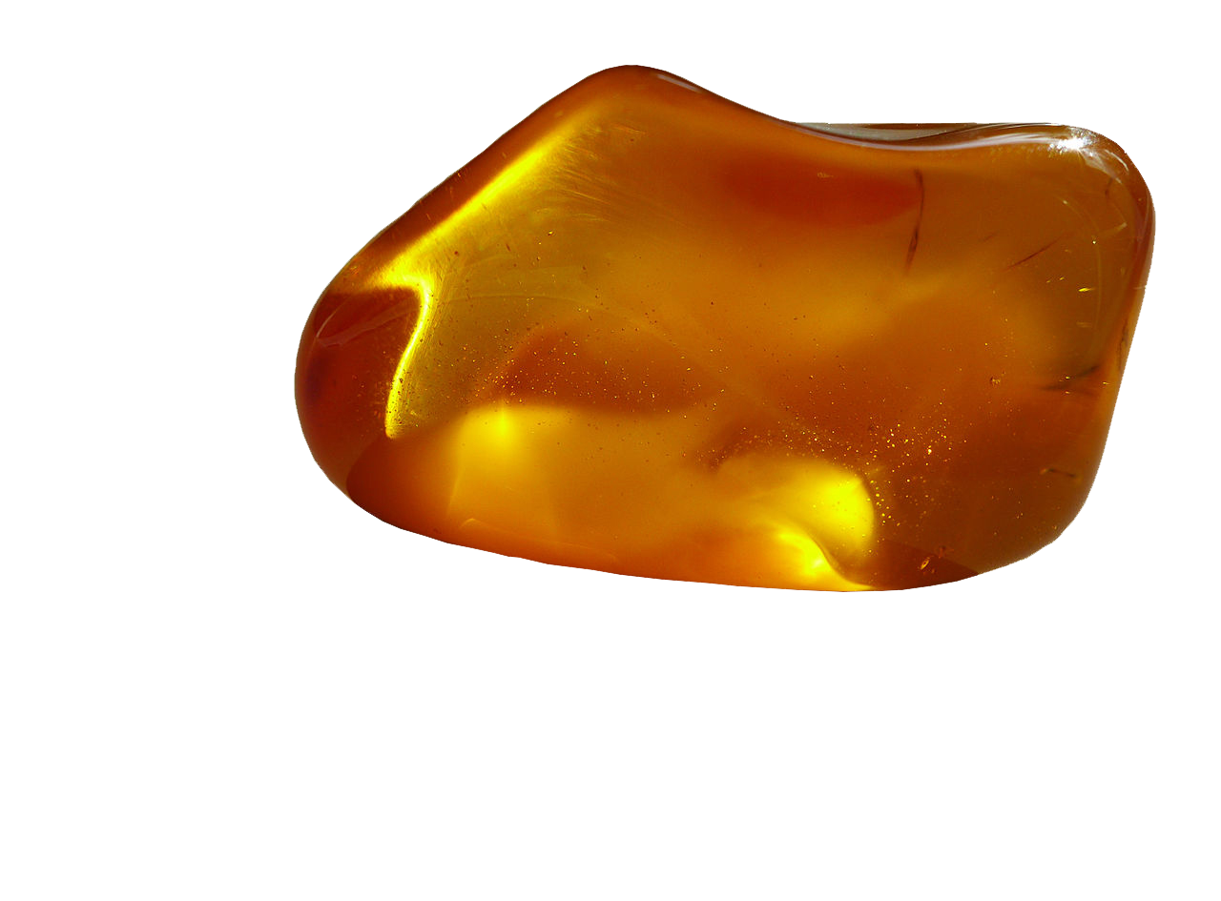
ELECTRICITY AND MAGNETISM
Electrification by friction

Slide 2
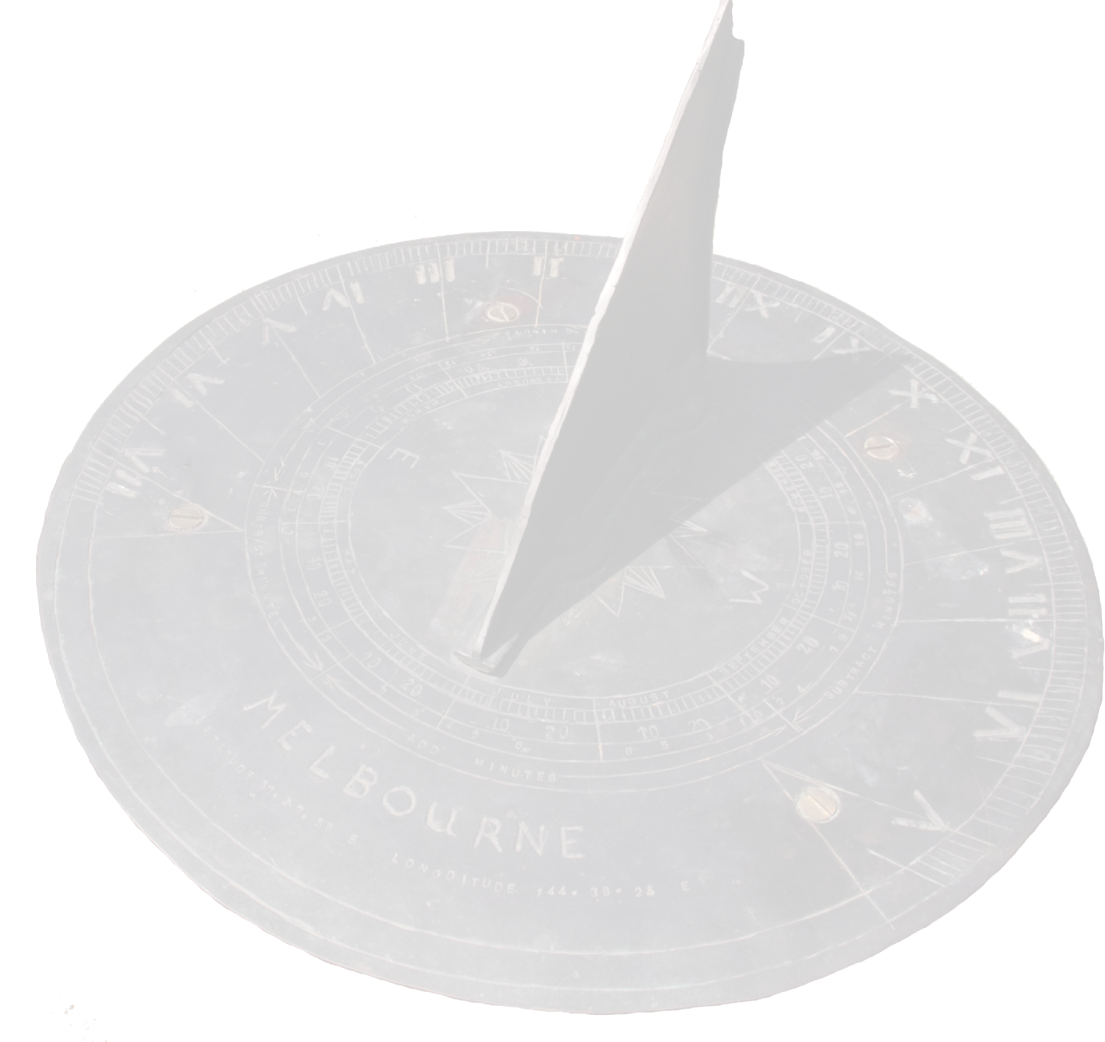
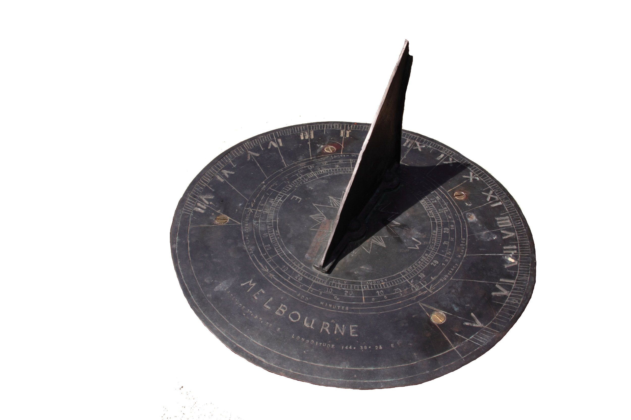
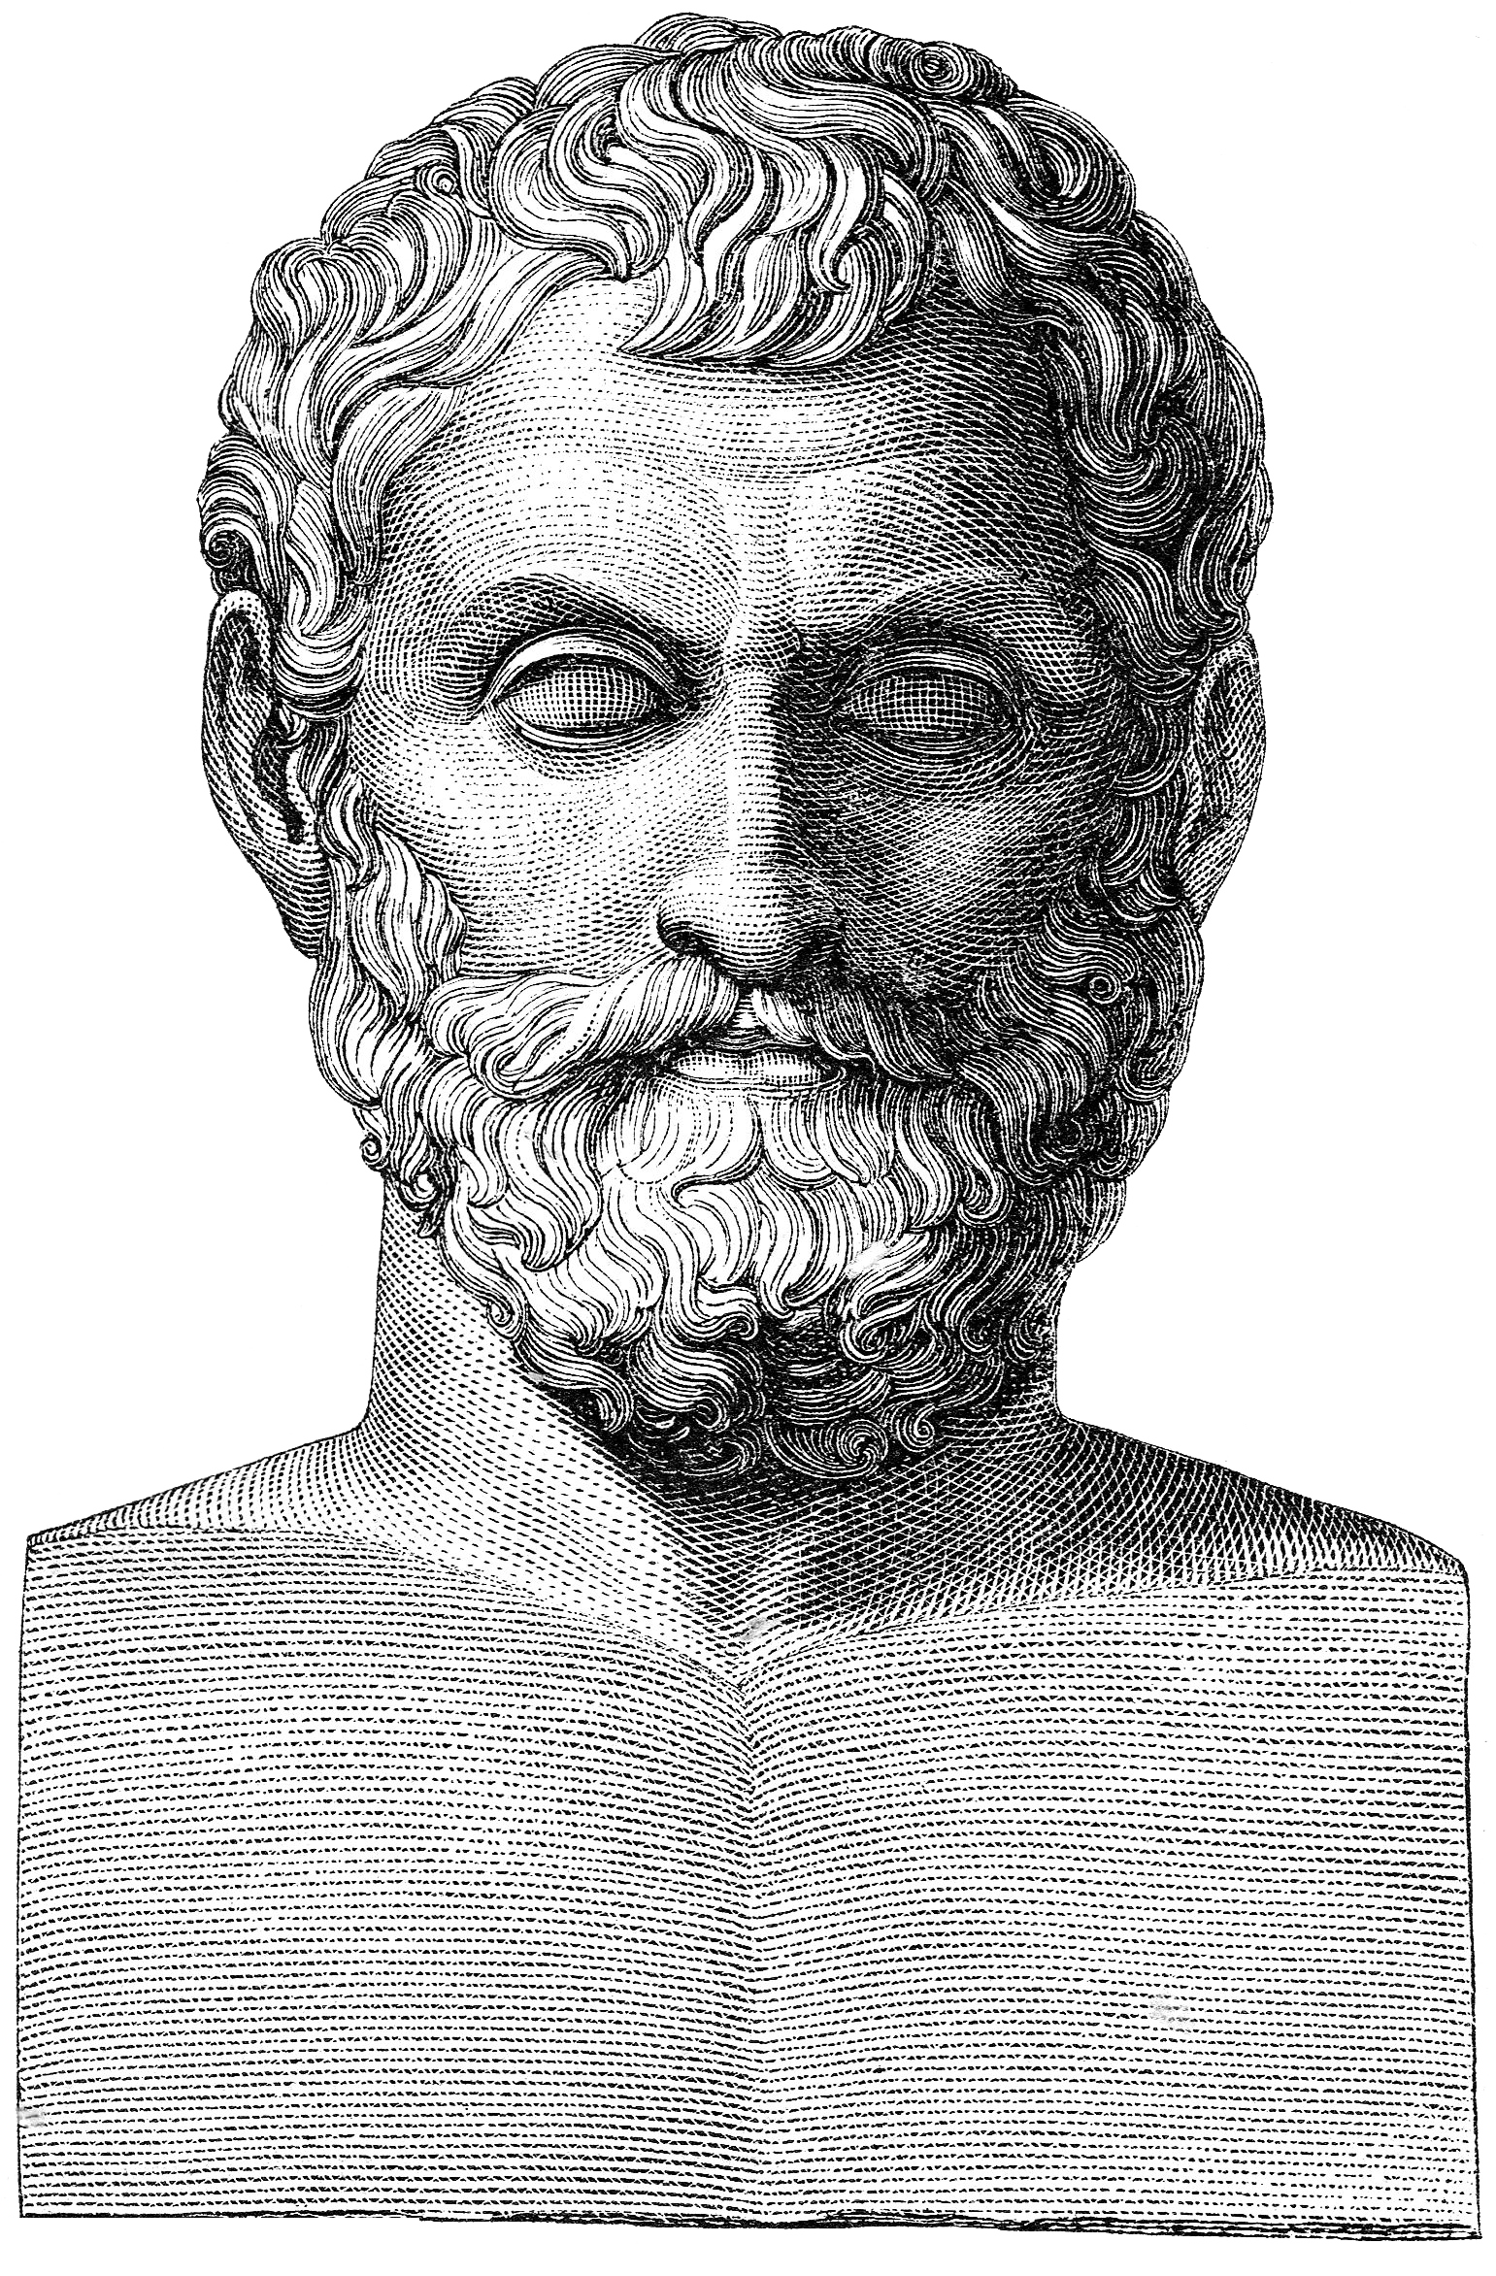
GLANCE TO THE PAST
Around 600 BC, in Asia Minor, the Greek philosopher, mathematician and astronomer Thales of Miletus noted that a translucent gemstone called “elektron” (amber) presents a mysterious faculty ...

Slide 3
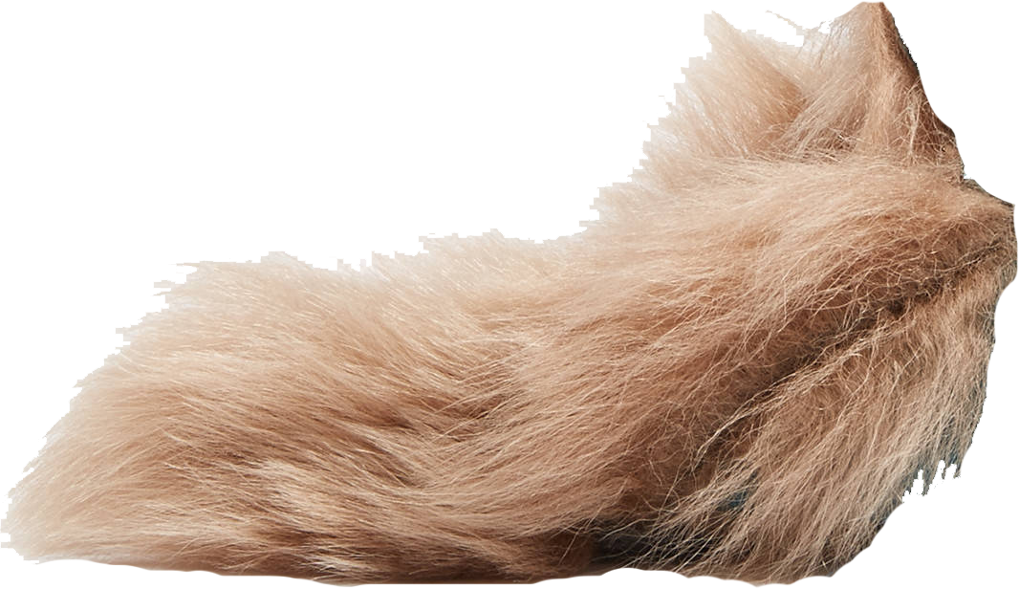
When “elektron” is rubbed with fur it acquires the ability to attract dust and other light objects.
The faculty of “elektron” (amber) was going to give origin to “electricity” and the microscopic particles “electrons”...

Slide 4
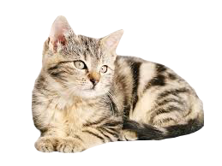
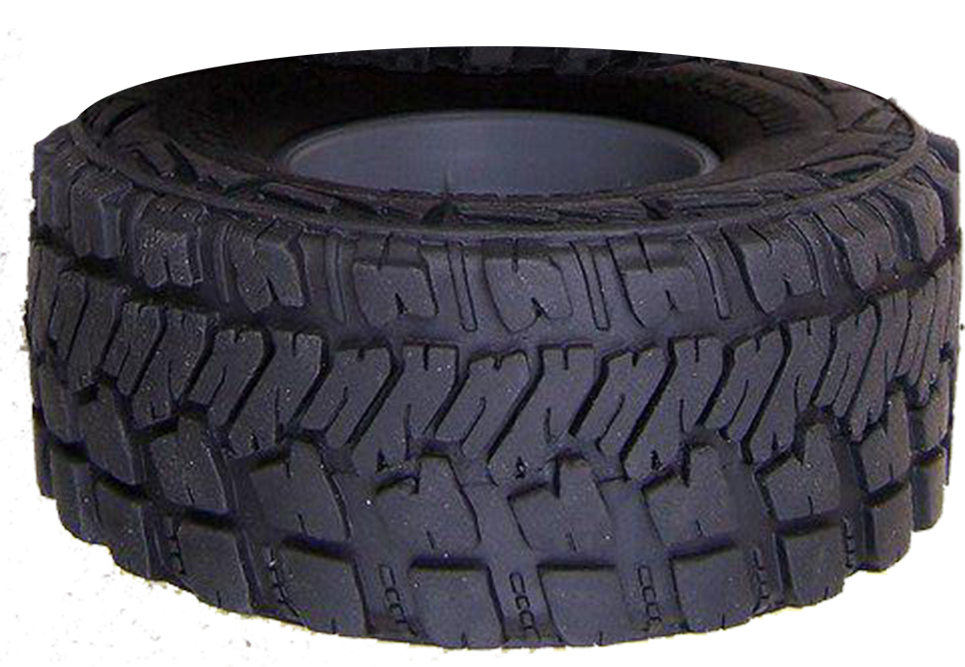
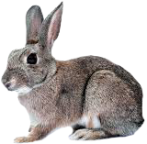
ELECTRIFICATION BY FRICTION
Like amber and fur, several other materials when rubbed with each other acquire a similar faculty. Then we say that they are “electrified by friction”.
But what is the common cause of these phenomena?

Slide 5
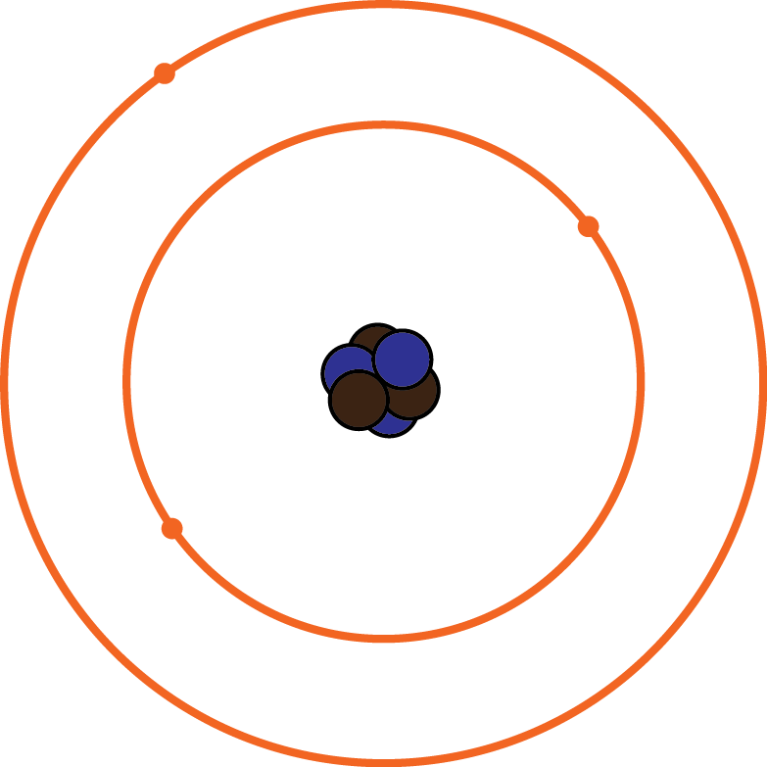
ELEMENTS OF MATTER
The answer lies in the microscopic elements of matter: Every kind of material consists of a different compound of atoms.

Slide 6
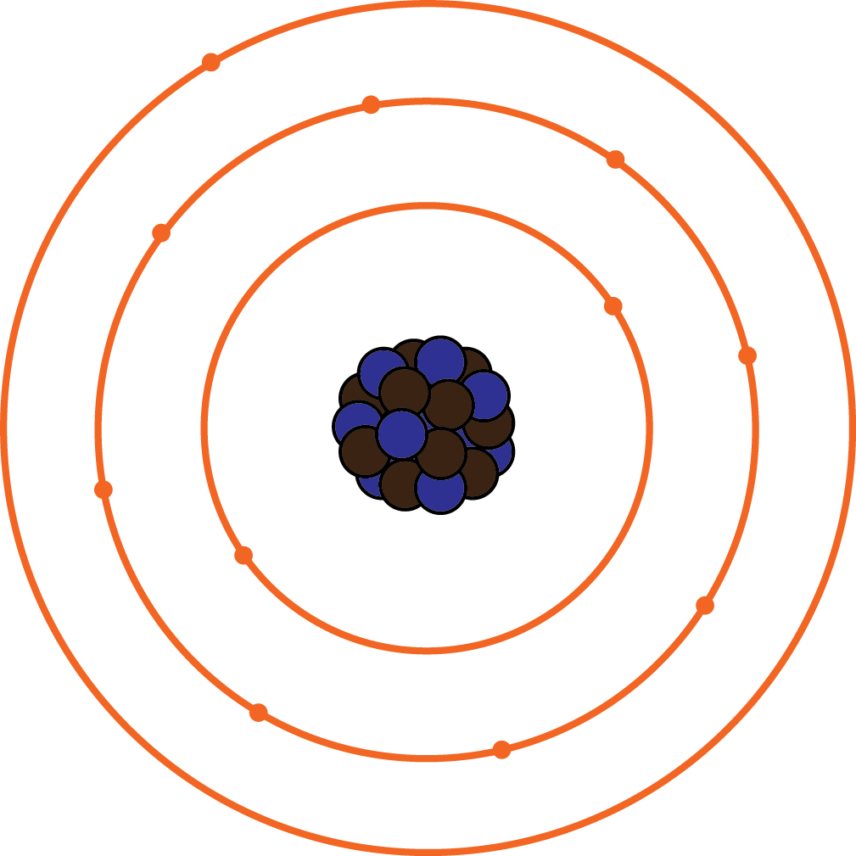
ELEMENTS OF MATTER
Atoms differ in mass and shape but all consist of three kinds of patricles: neutrons and protons constitute the nucleus (the core) of an atom, while electrons, which are 1.800 times smaller, orbit around the nucleus in different energy levels.
protons
neutrons
electrons

Slide 7
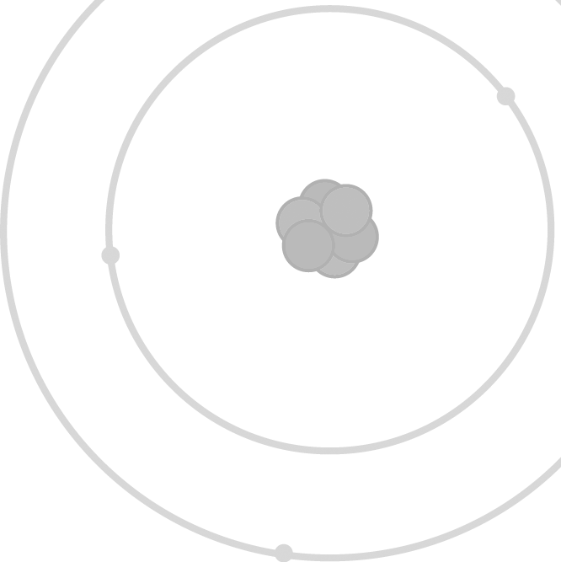
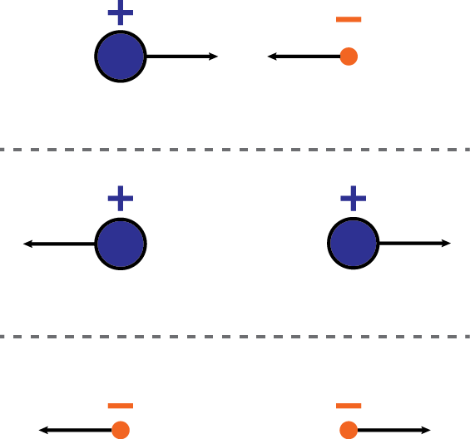
ELEMENTS OF MATTER
Protons and electrons are carriers of opposite charge –represented as “possitive” and “negative” charge– and are attracted to each other, while they repel particles of the same kind. Neutrons on the other hand bear no charge (they are “neutral”).

Slide 8
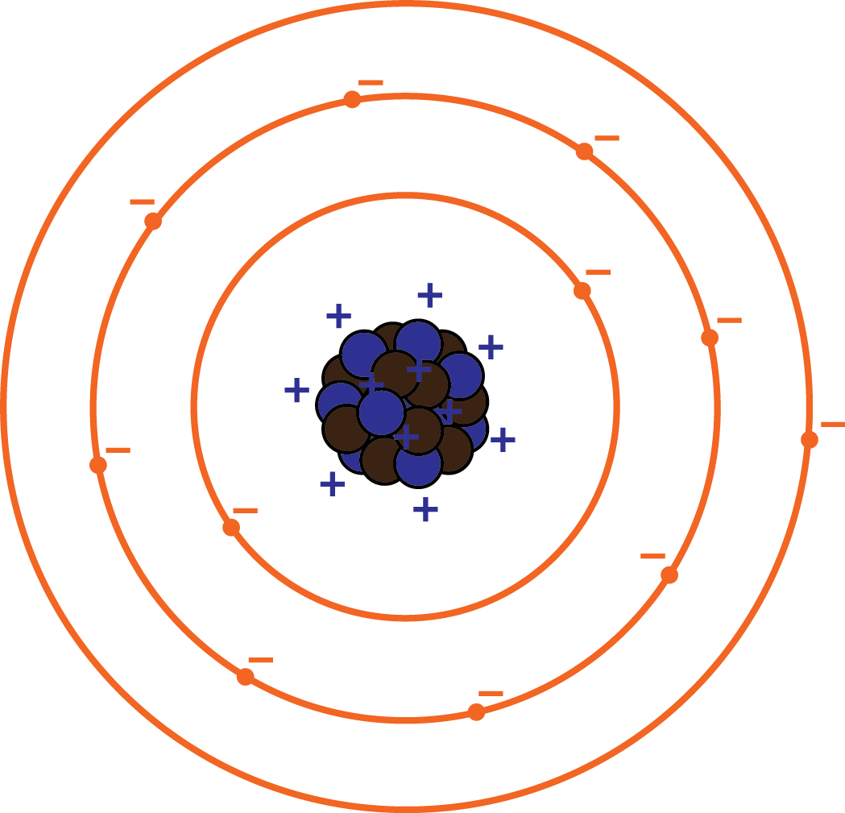
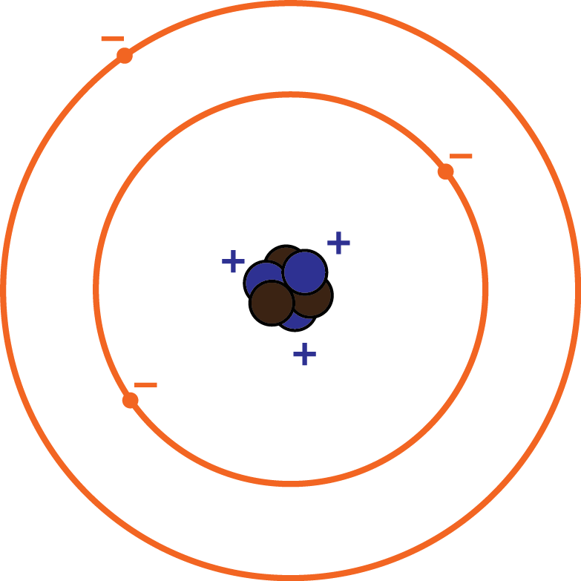
ELEMENTS OF MATTER
A “neutral” atom contains equal numbers of protons and electrons, thus on the whole it is not charged.
3 protons 3 electrons
11 protons 11 electrons
+11 -11 = 0
+3 -3 = 0

Slide 9
ELEMENTS OF MATTER
Although, electrons can move from one atom to another. In that case the first atom is charged “positively” (it contains more protons than electrons) and the second is charged “negatively”.
positively charged
negatively charged

Slide 10
ELEMENTS OF MATTER
3 protons 4 electrons
11 protons 10 electrons
+11 -10 = +1
+3 -4 = -1

Slide 11
ELEMENTS &
ELECTRIFICATION BY FRICTION
When fur is rubbed with amber, many electrons move from atoms of the fur to atoms of the amber. Thus, both objects are charged (or “electrified”) with opposite charges. This charge gives amber the power to attract light objects.
positively charged
negatively charged

Slide 12
ELEMENTS &
ELECTRIFICATION BY FRICTION
In many cases, when we rub two objects of different material, electrons tend to move preferably to one of them.
Electrification by friction takes place because different materials present different affinity for electrons!

Slide 13
SOURCES
P. G. Hewitt, Conseptual Physics, 11th ed., Pearson Education, 2010. “Charging by Friction” retrieved from the webpage “The Physics Classroom”: http://www.physicsclassroom.com/class/estatics/Lesson-2/Charging-by-Friction “Triboelectric Series” retrieved from the webpage of EOS/ESD Association, Inc.: https://www.esda.org/about-esd/esd-fundamentals/part-1-an-introduction-to-esd/

