Slide 1
Robots – Theory
Algorithm

Slide 2
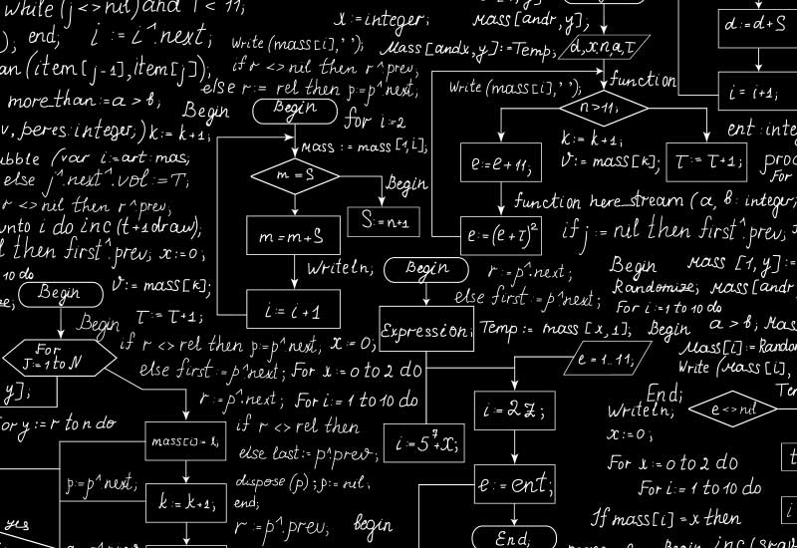
Algorithm
In mathematics and computer science, an algorithm is a self-contained sequence of actions to be performed. Algorithms can perform calculation, data processing and automated reasoning tasks.
An algorithm is an effective method that can be expressed within a finite amount of space and time and in a well-defined formal language for calculating a function.

Slide 3
Computer algorithms
In computer systems, an algorithm is basically an instance of logic written in software by software developers to be effective for the intended "target" computer(s) to produce output from given (perhaps null) input.
An optimal algorithm, even running in old hardware, would produce faster results than a non-optimal (higher time complexity) algorithm for the same purpose, running in more efficient hardware; that is why algorithms, like computer hardware, are considered technologys.

Slide 4
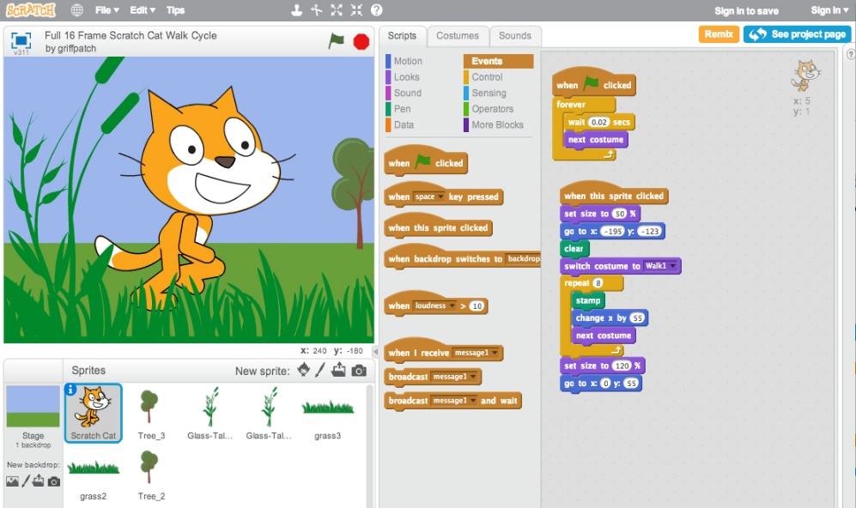
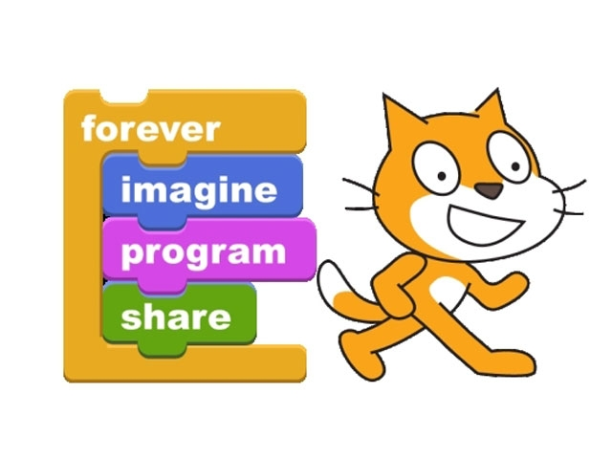
Computer algorithms
Not all algorithms are complicated languages!!! MIT in order to allow kids to learn how to develop interactive stories and animation in a collaborative manner. In a Scratch project, you can control sprites and make them move, interact… But the language proposed to control these sprites contain all the basics structures necessary in any algorithms.

Slide 5
Computer algorithms
Informally, an algorithm is any well-defined computational procedure that takes some value, or set of values, as input and produces some value, or set of values, as output. An algorithm is thus a sequence of computational steps that transform the input into the output.
The various concepts that will be investigated in the sequel are the following ones :
Sequence of statements
Introduction to variables
Conditional statements
Loop statements

Slide 6
Sequence of statements
As defined before, an algorithm is thus a sequence of computational steps that transforms the input into the output. We can define each of these steps as a statement (e.g. variable declaration, loop statement, conditional statement…).
Variables
In a variable, we can store a numerical value (integer or float), string value or Boolean (only true or false). In an algorithm, it is often useful and necessary to store results of intermediate computations and to be able to reuse them in the sequel of the algorithm
Ex: x= 10 ; y=20 ; a = x +y;

Slide 7
Sequence of statements
Conditional statements
These statements can execute a set of statements if and only if a condition is true or choose between two sets of statements depending on the condition value.
It can take the two following forms:
IF​ (condition is true) THEN execute a set of statements END IF | IF​(condition is true) THEN execute set of statements1 ELSE execute set of statements2 END IF

Slide 8
Sequence of statements
Loop statements
In algorithms, it is often useful to repeat several times the same statements. At each new call of the set of statements, only the value of a variable can be modified. It avoids write several times the same lines in the algorithm
Loop statements can take following forms:
LOOP ​(N times) set of statements END LOOP | LOOP​WHILE​(condition is true) set of statements END LOOP WHILE

Slide 9
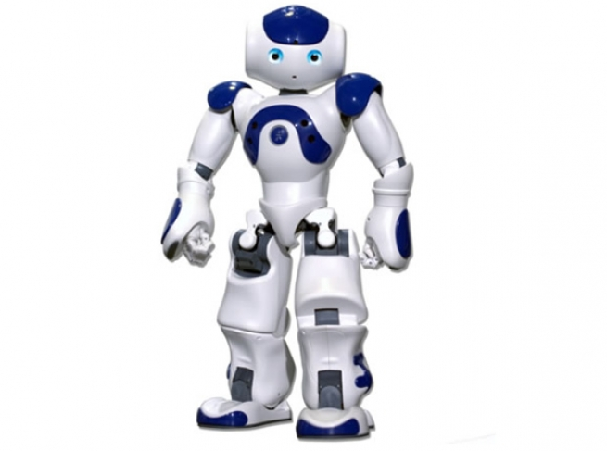
Robot algorithms
As modern robots address real-world problems in dynamic, unstructured, and open environments, novel challenges arise in the areas of robot control algorithms and motion planning.
These challenges stem from an increased need for autonomy and flexibility in robot motion and task execution. Adequate algorithms for control and motion planning will have to capture high-level motion strategies that adapt to sensor feedback

