Slide 1
Gamification
Basic Gaming Mechanisms

Slide 2
Achievements Achievements are a representation of having accomplished something. Achievements can increase the challenge of the game and motivate users even more. Achievements are often considered "locked" until you have completed the steps or tasks that are required to "unlock" them. Many gamification platforms offer Badges when completing tasks.
Appointments The user has to log-in and/or make an action in game at a predetermined time or place to complete a task.

Slide 3
Blissful Productivity Giving the user the impression that they are doing something meaningful and rewarding.
Bonuses These are rewards that are applied for completing some special challenge or combination of challenges.
Cascading Information Theory During the game progression the information is released in small snippets, in order for the user to retain the appropriate level of understanding.

Slide 4
Combos These involve the combination of different things and usually come with additional rewards.
Community Collaboration A entire community is motivated to work together and try to solve a riddle or a challenge.
Countdown The user has a limited amount of time to complete a task.

Slide 5
Exploration Encouraging the user to explore and discover new places / pages.
Epic Meaning Inspiring the user that they are working to achieve something great, something bigger than themselves.
Infinite Gameplay Some games do not have an explicit end. Many of these games have a way to dynamically generate content, tasks and rewards to keep the users engaged.

Slide 6
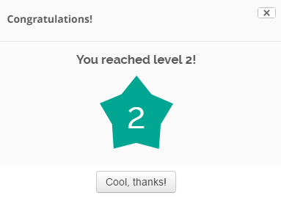
Levels The user's level is incremented after gathering a predetermined number of points or completing specific tasks. Progressing to higher levels usually involves unlocking new features or abilities for the user.
Loss Aversion The user is punished or losses resources if they fail to do some task or if they do some mistake or an action against some rules.
Lottery The user completes some task or gets a reward solely by chance.

Slide 7
Ownership The user can become attached with their character/pets or creations inside a game. This is particularly the case when the game allows a high level of customization.
Points Points are a numerical value given for any action or combination of actions completed by the user.

Slide 8
Progression The progress of the user can be displayed and measured through the process of completing itemized tasks.
Quests A quest is a specific obstacle, challenge or task that the user has to complete to receive a reward. A quest can be linked with another follow-up quest, forming quest-chains

