Slide 1
Von Neuman
RAM – Random Access Memory

Slide 2
Introduction
Random-access memory (RAM) is a form of computer data storage. A random-access memory device allows data items to be accessed (read or written) in almost the same amount of time irrespective of the physical location of data inside the memory.
RAM contains multiplexing and multiplexing circuitry, to connect the data lines to the addressed storage for reading or writing the entry. Usually more than one bit of storage is accessed by the same address, and RAM devices often have multiple data lines and are said to be '8-bit' or '16-bit' etc. devices.

Slide 3
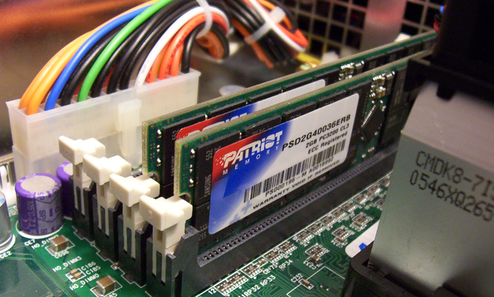
Random-access memory
There are 3 types of memory that currently popular used in the PC,
1. RD RAM
2. DDR RAM
3. SD RAM
https://thetechjournalcom-asifbd.netdna-ssl.com/wp-content/uploads/2012/10/ram-windows-speed-up.jpg

Slide 4
Random-access memory
RDRAM Memory
-Used in Pentium 4 motherboard
- 2 Notches
-highest performance and is most
expensive.
DDR ram
-128 MB, 256 MB, 512 MB.
-medium high performance and
medium price.
SDRAM
-lowest performance and lowest
price.

