Slide 1
Von Neuman
Motherboard

Slide 2
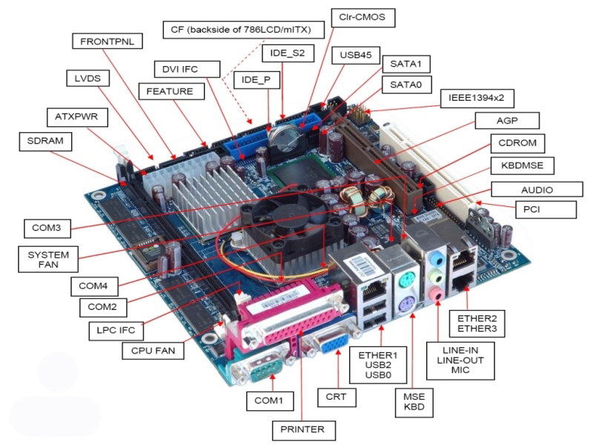
Introduction
Motherboard is a main (PCB) printed circuit board where are all the components or devices are connected directly and indirectly.

Slide 3
TYPES OF MOTHERBOARD
Integrated Motherboard
Non Integrated Motherboard
Desktop Motherboard
Laptop Motherboard
Server Mother Bord
At Motherboard
Atx Motherbord

Slide 4
Types of motherboard based on devices they support
Integrated motherboard
Non integrated motherboard

Slide 5
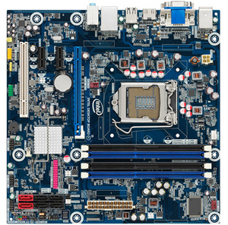
Integrated motherboard
An integrated system board has multiple components integrated into the board itself. These may include the CPU video card , sound card and various controller cards.

Slide 6
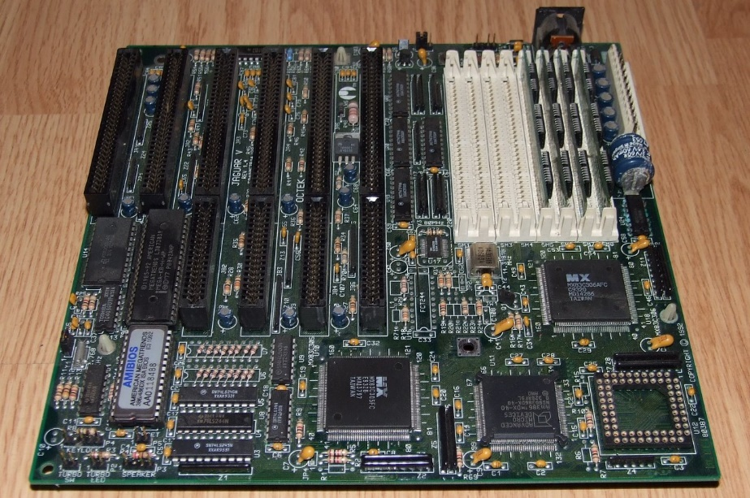
Non integrated motherboard
Non integrated system board uses installable components and expansion cards. For example, non integrated system board may allow you to upgrade the video card by removing the old one and installing a new one. Non integrated motherboard typically have several PCI expansion slots as well.

Slide 7
Types of motherboard Based on form factor
1. AT
2 . ATX

Slide 8
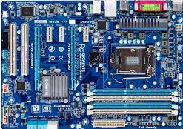
At MotherboARD
At motherboard is a motherboard which has dimensions of the order of some hundred millimeters, big enough to be unable to fit in mini desktop.

Slide 9
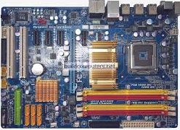
ATX MOTHERBOARD
Advanced technology extended, or popularly known as the atx, are the motherboard which were produced by the intel in mid 90`s as an improvement from the previously working motherboard such as at.

Slide 10
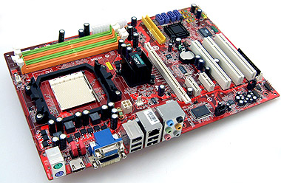
Desktop motherboard
Desktop motherboard are used in personal or desktop computer. As it is used for application at home and in office, this type of motherboard is the most basic type

Slide 11
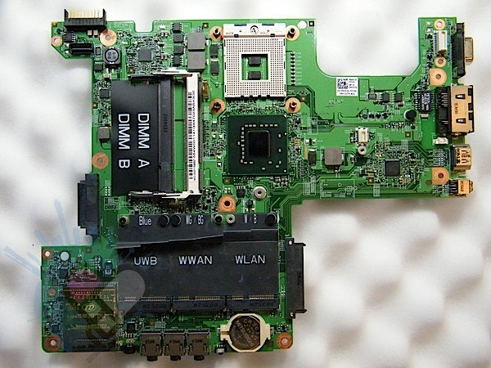
Laptop motherboard
Laptop motherboard is used to connect different parts of a laptop system. These motherboard generally have very advanced features as compared to the desktop motherboard and most of the functions have been integrated into the laptop motherboard

Slide 12
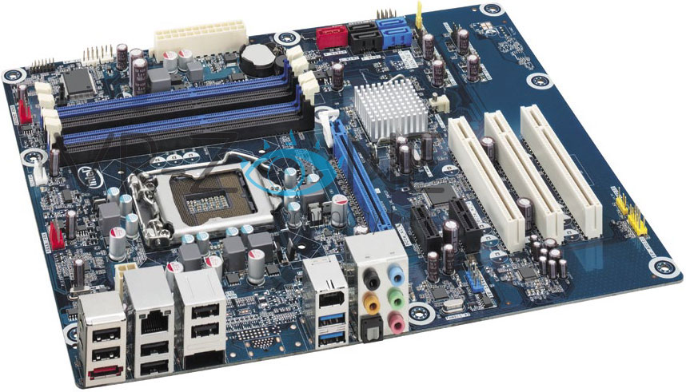
Server motherboard
Server motherboard are more advanced then desktop motherboard and are designed to offer high -end service which are more reliable and ready to operate in 24*7 environments.

