Slide 1
Von Neuman
GPU – Graphics Processing Unit and PCI Express

Slide 2
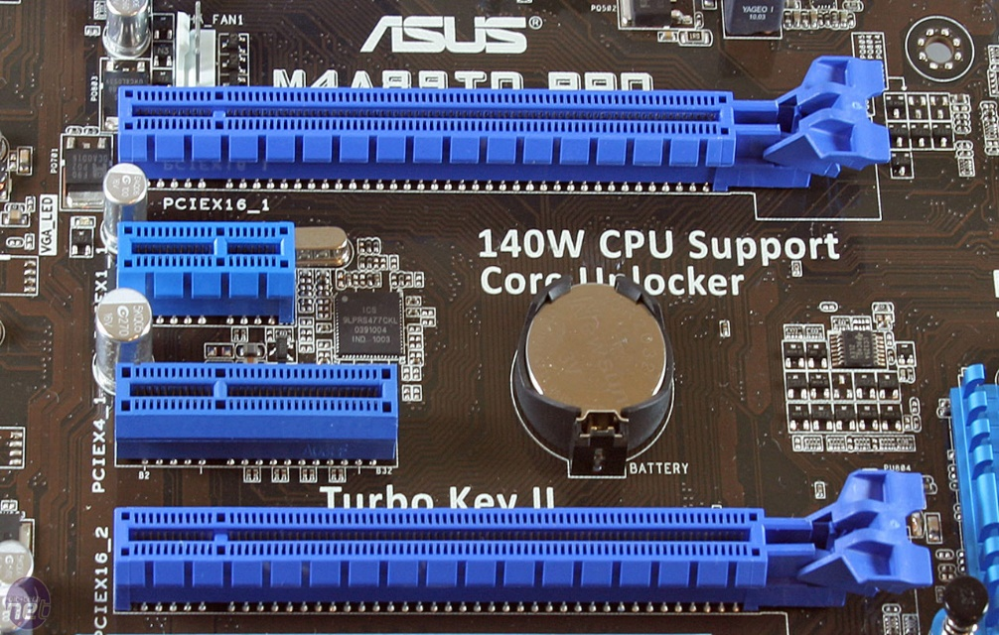
Introduction
Conventional PCI, often shortened to PCI, is a local computer bus for attaching hardware devices in a computer. PCI is the initialism for Peripheral Component Interconnect and is part of the PCI Local Bus standard.
Typical PCI cards used in PCs include: network cards, sound cards, modems, extra ports such as USB or serial, TV tuner cards and disk controllers.

Slide 3
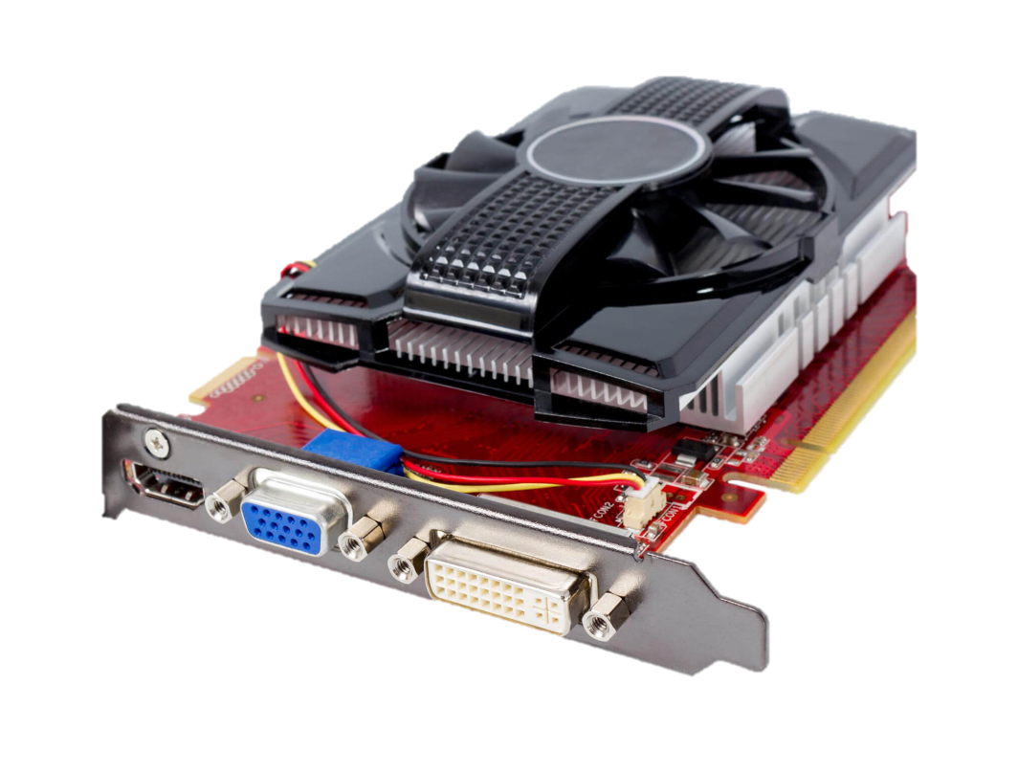
Introduction
A graphics processing unit (GPU), also occasionally called visual processing unit (VPU), is a specialized electronic circuit designed to rapidly manipulate and alter memory to accelerate the creation of images in a frame buffer intended for output to a display.
In a personal computer, a GPU can be present on a video card, or it can be embedded on the motherboard or—in certain CPUs—on the CPU die.

