Slide 1
Von Neuman
CPU

Slide 2
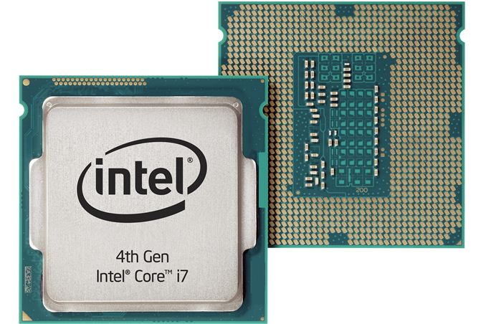
Introduction
A central processing unit (CPU) is the electronic circuitry within a computer that carries out the instructions of a computer program by performing the basic arithmetic, logical, control and input/output (I/O) operations specified by the instructions.

Slide 3
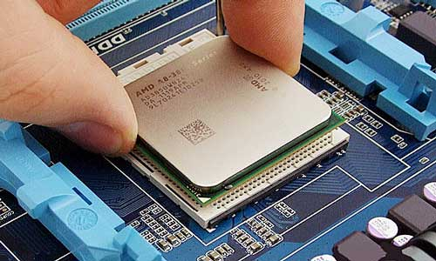
CPU
The CPU is one of the main portions of the computer, that carries out instructions to the computer program
CPU performs arithmetical, logical and input/output operations
The designs of the CPU may have changed, but they all perform the same operations

Slide 4
CPU
Components of a CPU
Two main components
Arithmetic Logic Unit
Control Unit

Slide 5
ALU(Arithmetic Logic Unit)
The unit that performs arithmetic and logic operations such as addition, subtraction, shifting operations and logic instructions (Boolean comparisons, such as AND, OR, XOR, and NOT operations)
ALUs are designed to perform integer calculations. Therefore, besides adding and subtracting, ALUs often handle the multiplications, since the result is also an integer

Slide 6
ALU(Arithmetic Logic Unit)
FPU (Floating-Point Unit)
ALUs typically do not perform division operations, as the result may be a fraction, or a "floating point" number. Instead, division operations are usually handled by the FPU, which also performs other non-integer calculations 6 ALU (Arithmetic Logic Unit)

Slide 7
Control Unit (CU)
The control unit is basically circuitry inside the CPU, controlling the operations inside the CPU and "directing traffic" in a sense. The functions a control unit performs can depend on the type of CPU, since the varying degrees of architecture between all the different CPUs will determine the functions of the control unit
Handles all processor control signals. It directs all input and output flow, fetches code for instructions from microprograms and directs other units and models by providing control and timing signals 8 Control Unit (CU)

Slide 8
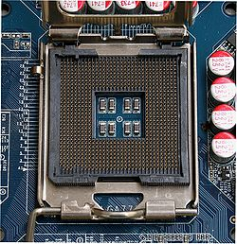
CPU Socket
A CPU socket or slot is an electrical component that attaches to a printed circuit board (PCB) and is designed to house a CPU (also called a microprocessor).
It is a special type of integrated circuit socket designed for very high pin counts.
CPU sockets on the motherboard can most often be found in most desktop and server computers (laptops typically use surface mount CPUs), particularly those based on the Intelx86 architecture.

